Slide 1




Glance of Bhanupriya craft presentation
Introduction
Software engineer by profession, ingenious, diligent and calm by nature.
Craft Task
Created a Bid request portal with existing project. It can be edited and view in a list and also bid can be deleted.
Achievements
10 Year IT career, with Masters In IT degree with High distinction. A lovely daughter to my parents and caring wife.
Why Intuit?
Job stability, international culture at work, longterm engagement, amazing product
Notes:
© Copyright PresentationGO.com – The free PowerPoint and Google Slides template library

Slide 2



z
Coding is my first love
The skills evolutions are like a Fibonacci series of skills started with
2011
2015
2016
2020
Javascript+HTML+CSS+PHP+Mysql
2012
KineticJS+Java+ORM
AngularJS+SpringBoot+Oracle+Node
React2016+Mongo+Express
React2018+Redux+Python+Machine learning+ Block chain

Slide 3
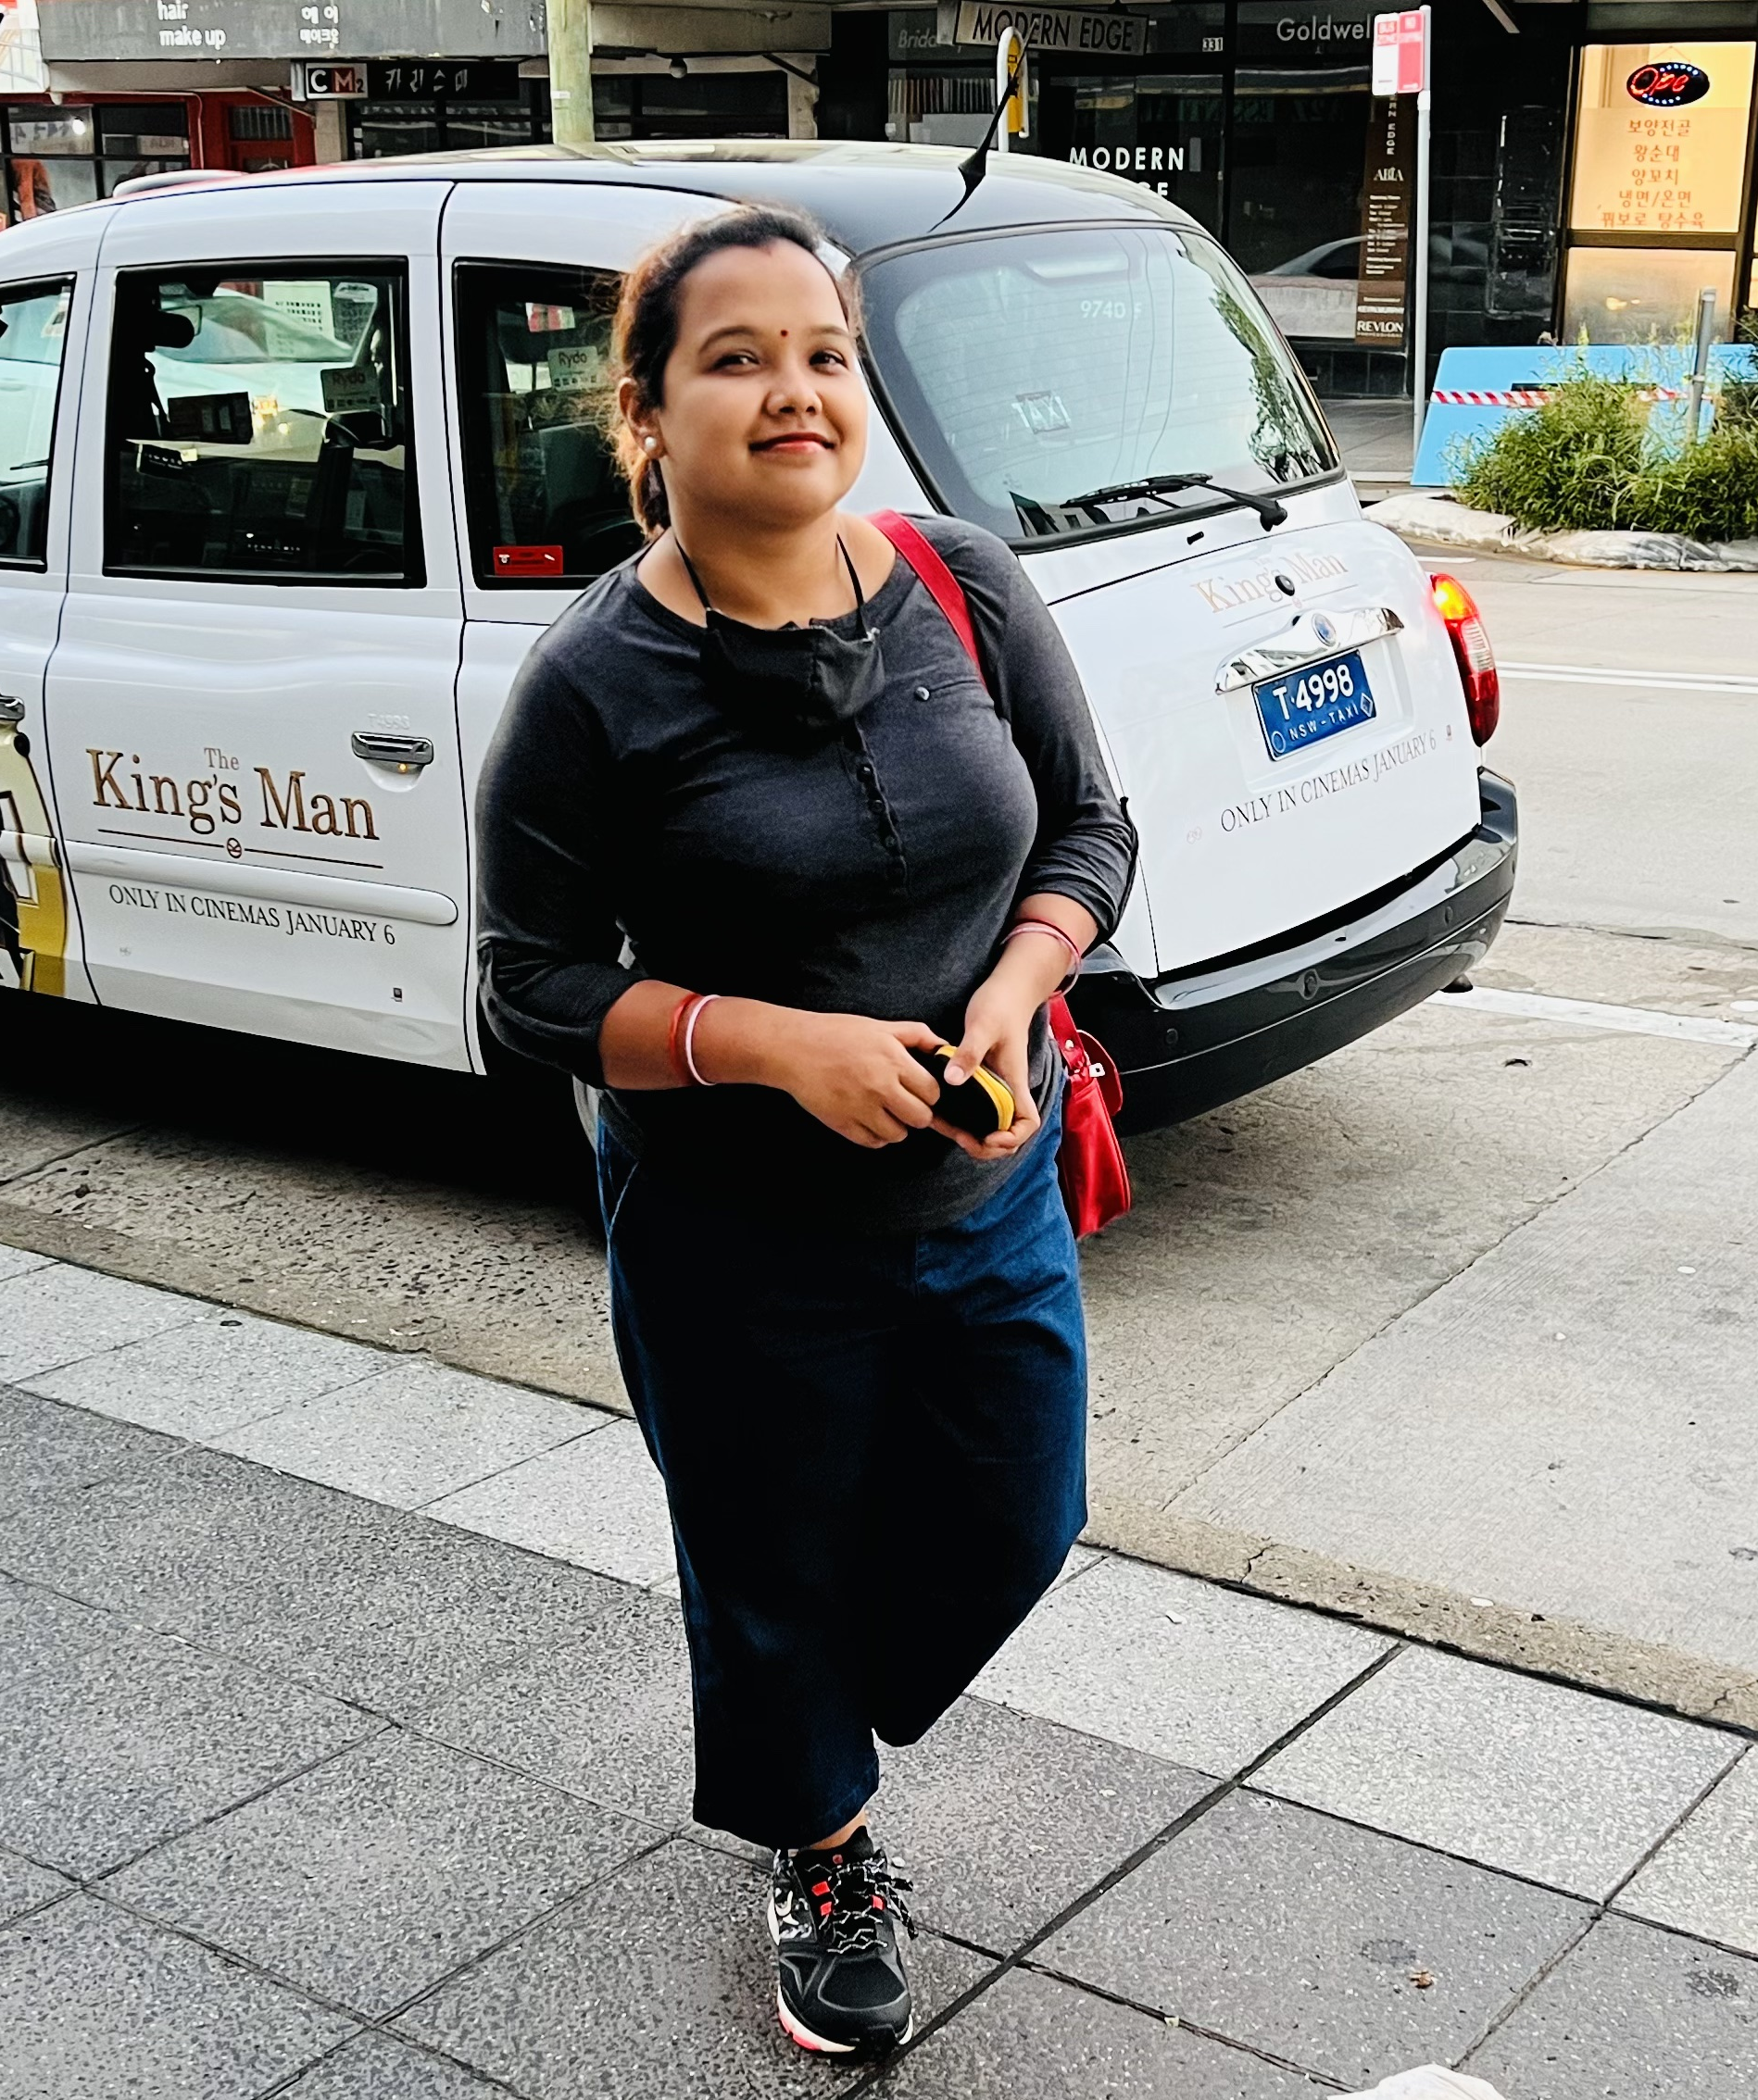
I love walking, Cooking, & shopping
World seems shorter, once I am on my sneakers

Slide 4

Achievement
A progressive career with healthy family life
z

Slide 5
Masters in IT degree with High Distinction
Cross domain delivery with top notch projects
Best performance award for project implementation in ATDD
State level debater during academics
Accessibility compliance recognition
z

Slide 6
Challenges Solved
Javascript player in Impelsys
Netter reference canvas layout
iDrac – Dynamic form generation
Chase - thirdparty integration
Chase – ADA implementation
Planning Tree at cascade
Audit log in Westpac

Slide 7
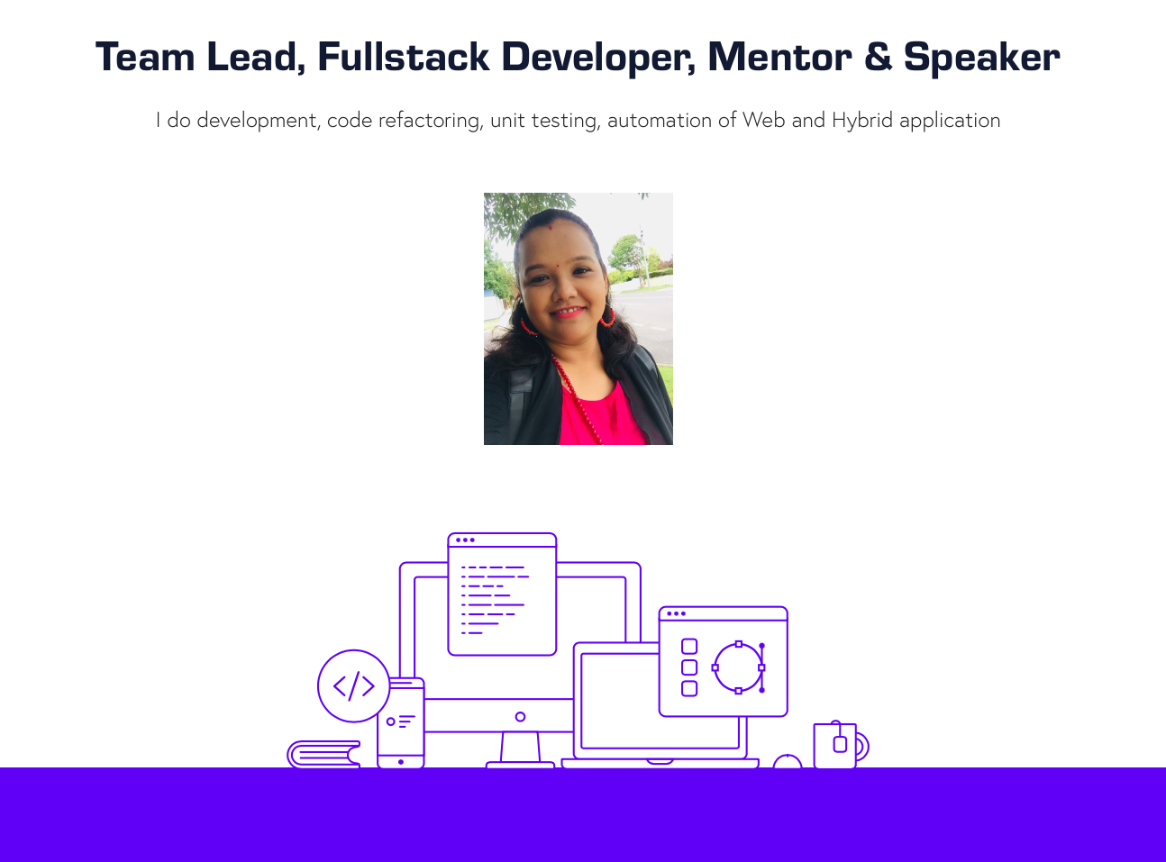
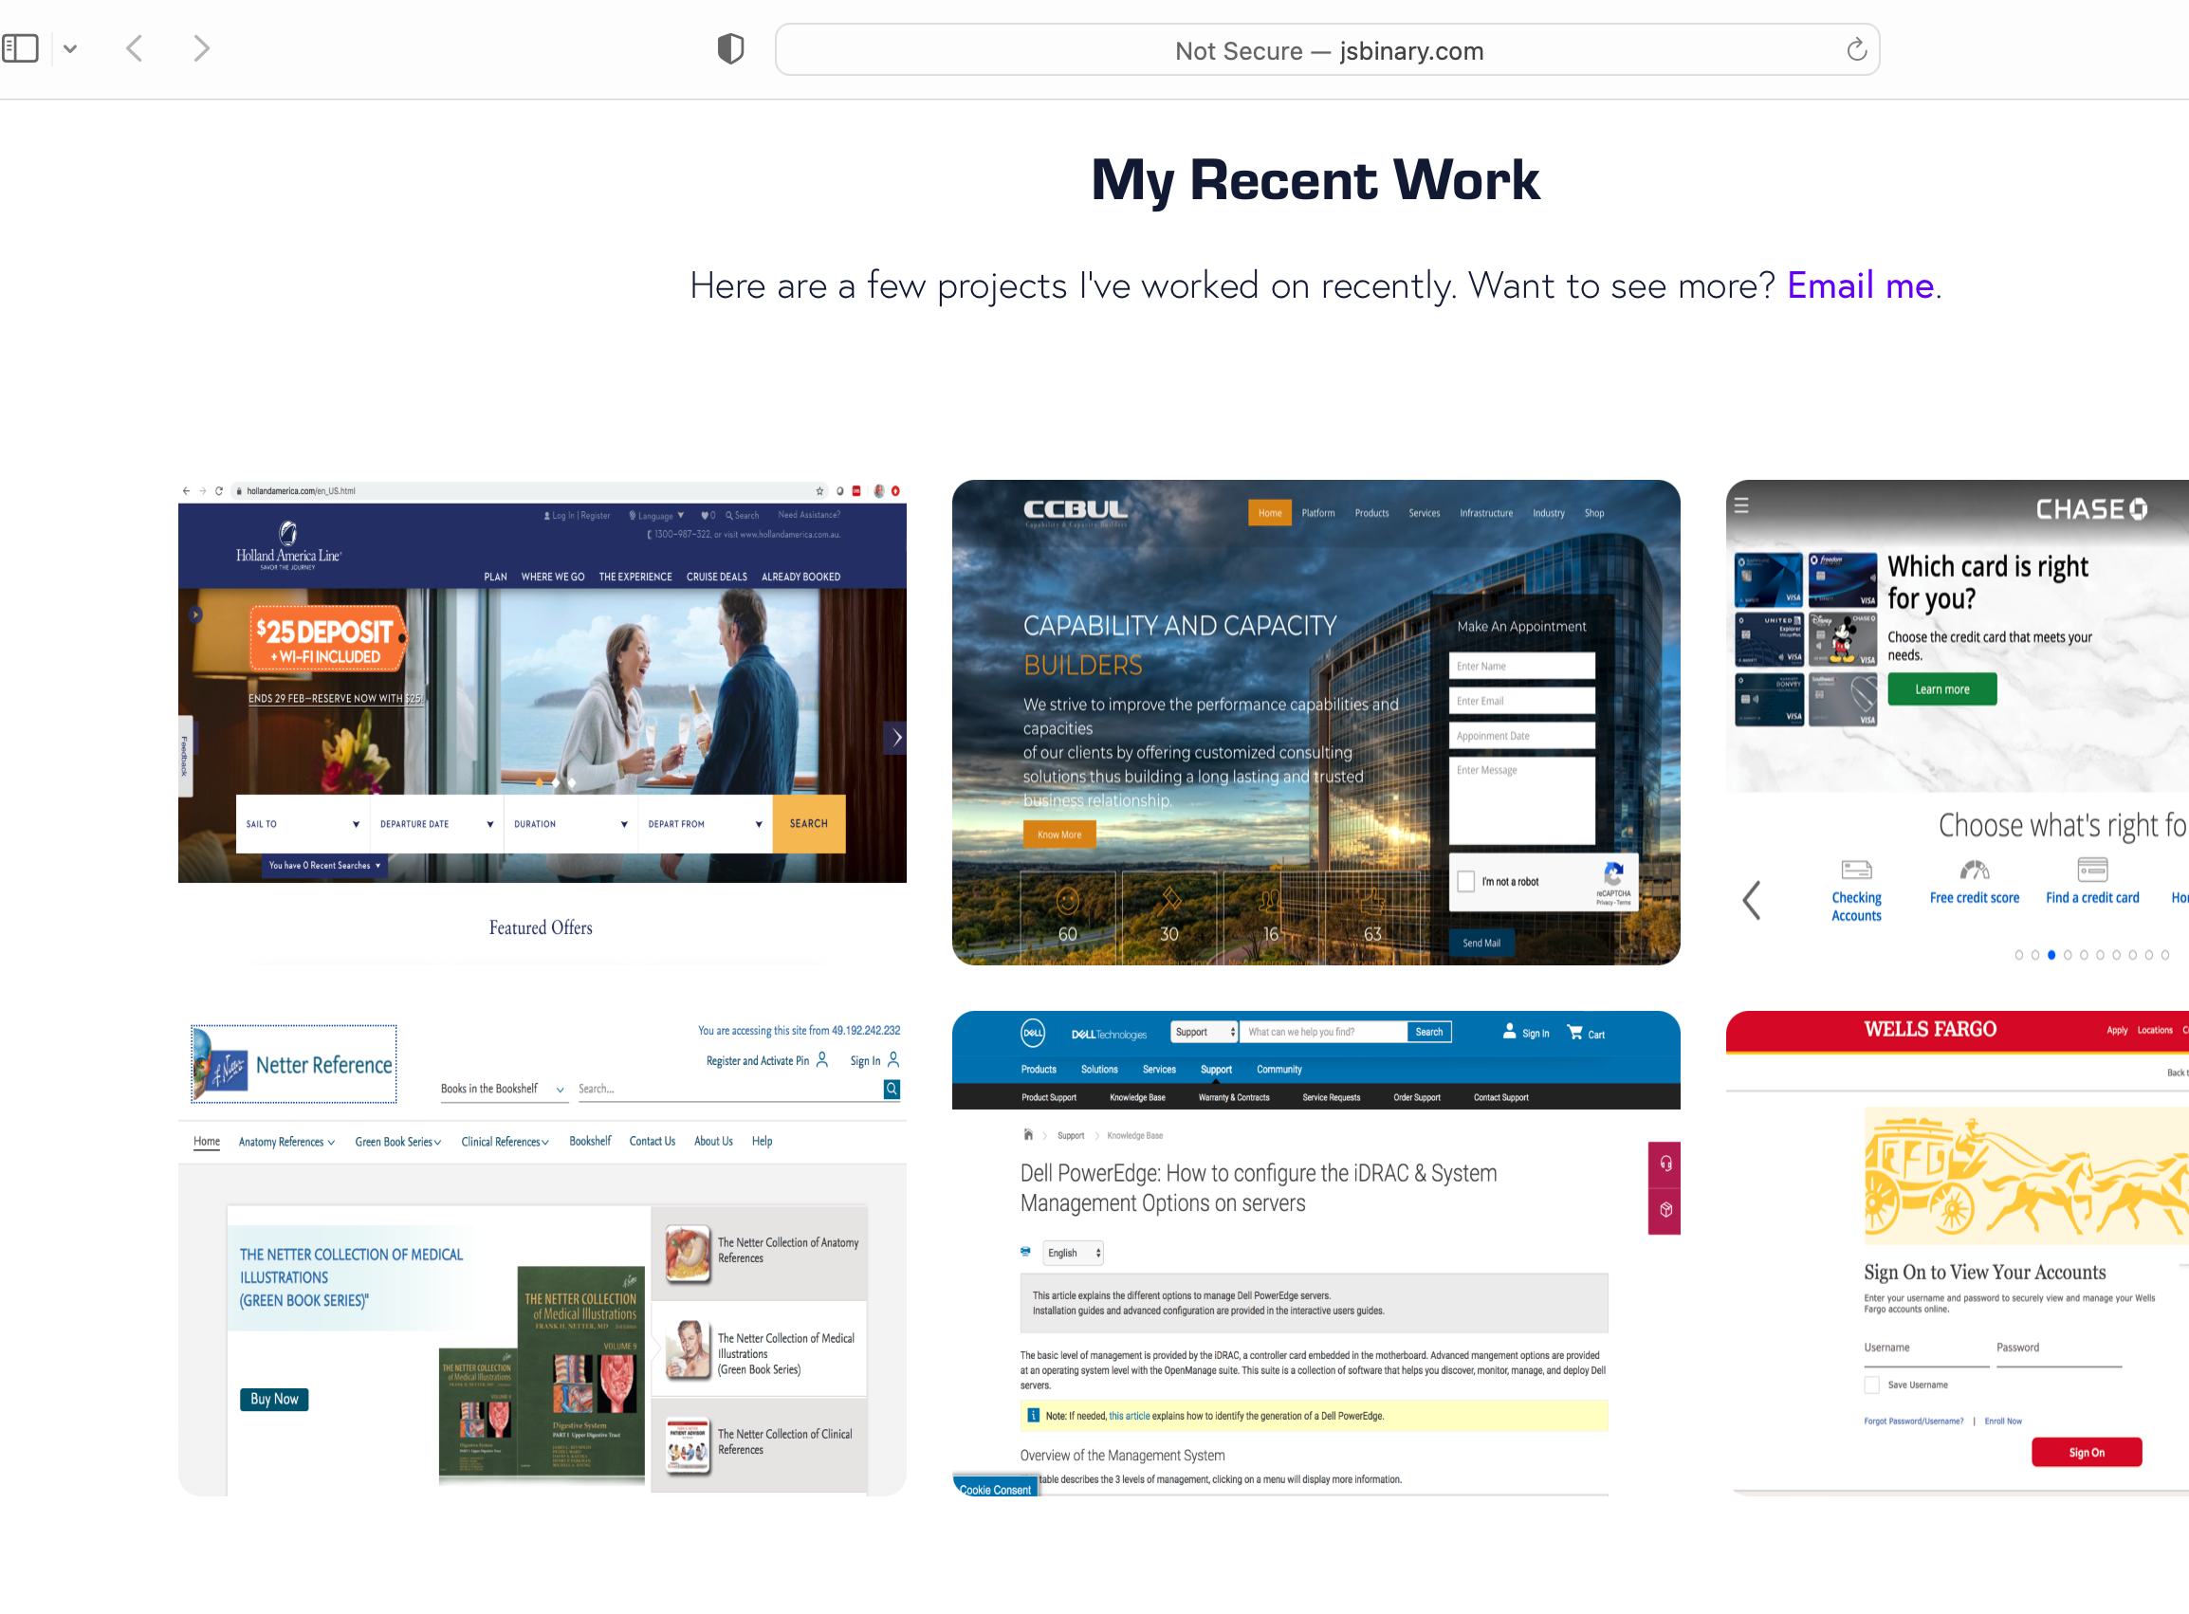
A glance of my portfolio
z

Slide 8
Craft Task - Bidder portal
z

Slide 9
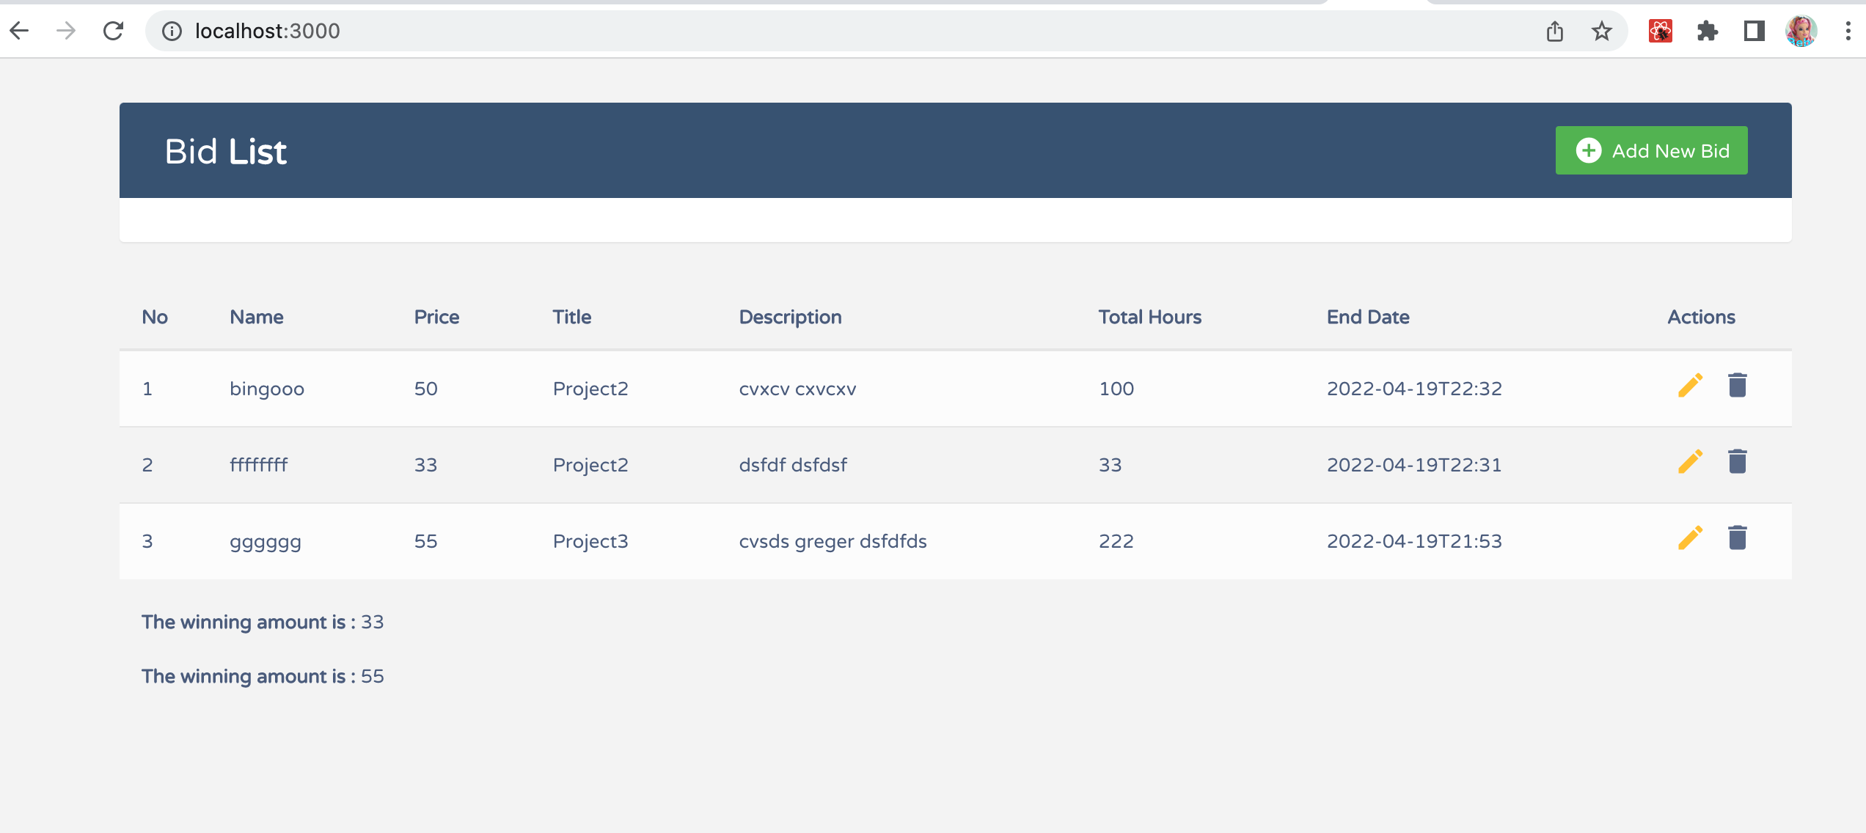
Bid List

Slide 10
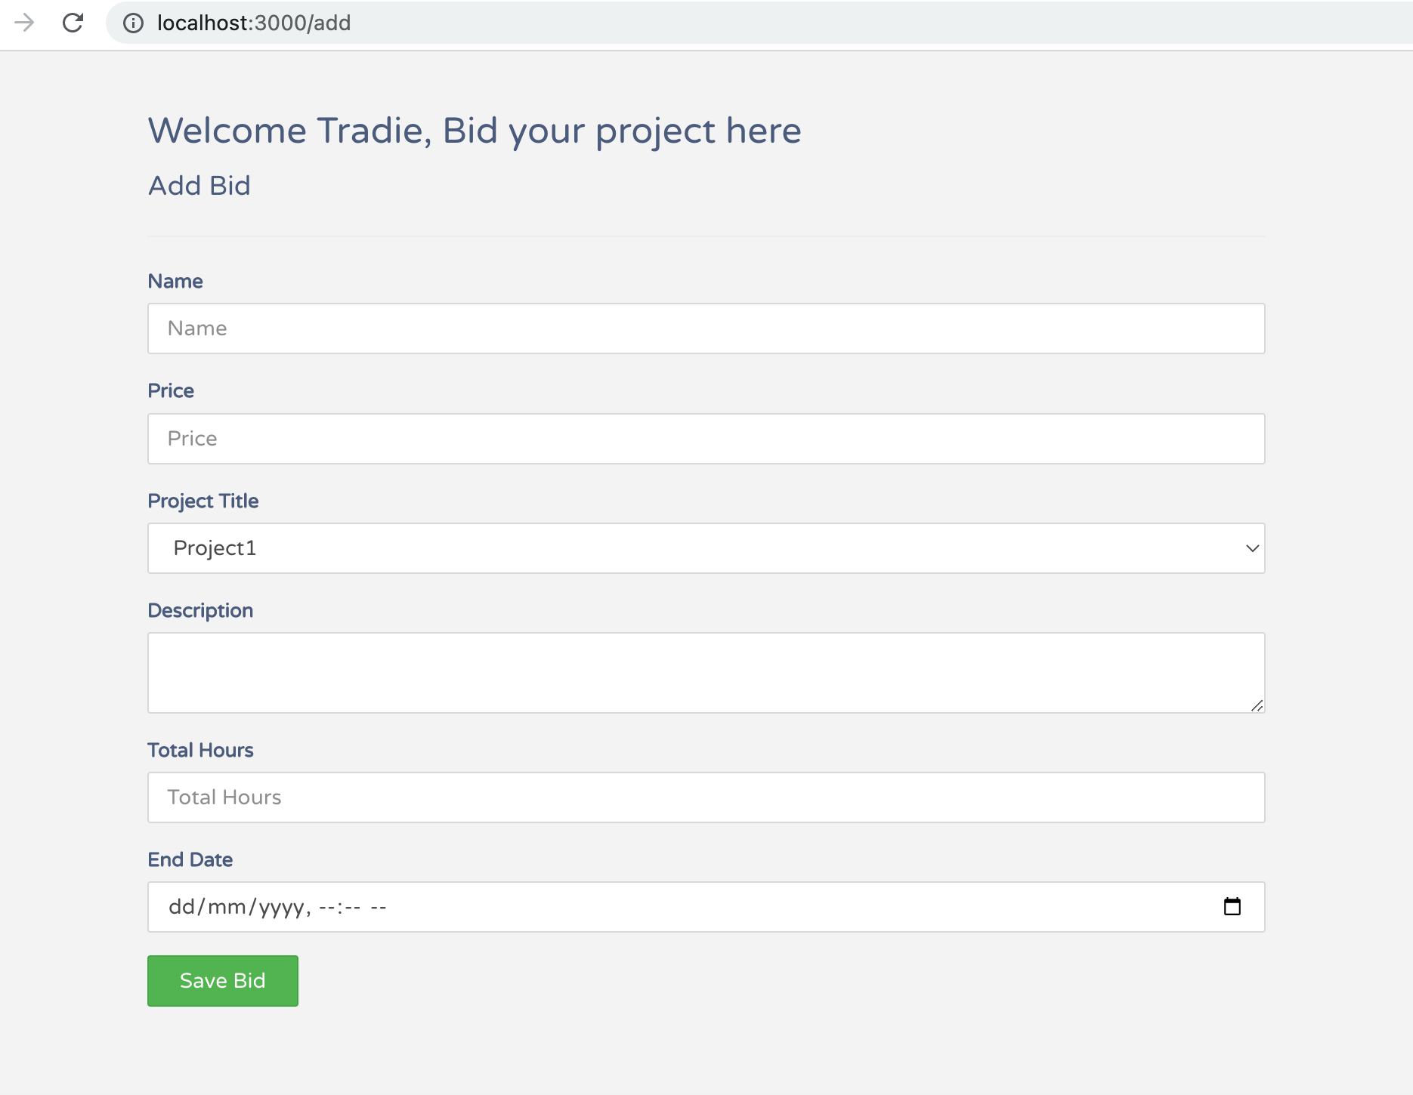
Add Bid

Slide 11
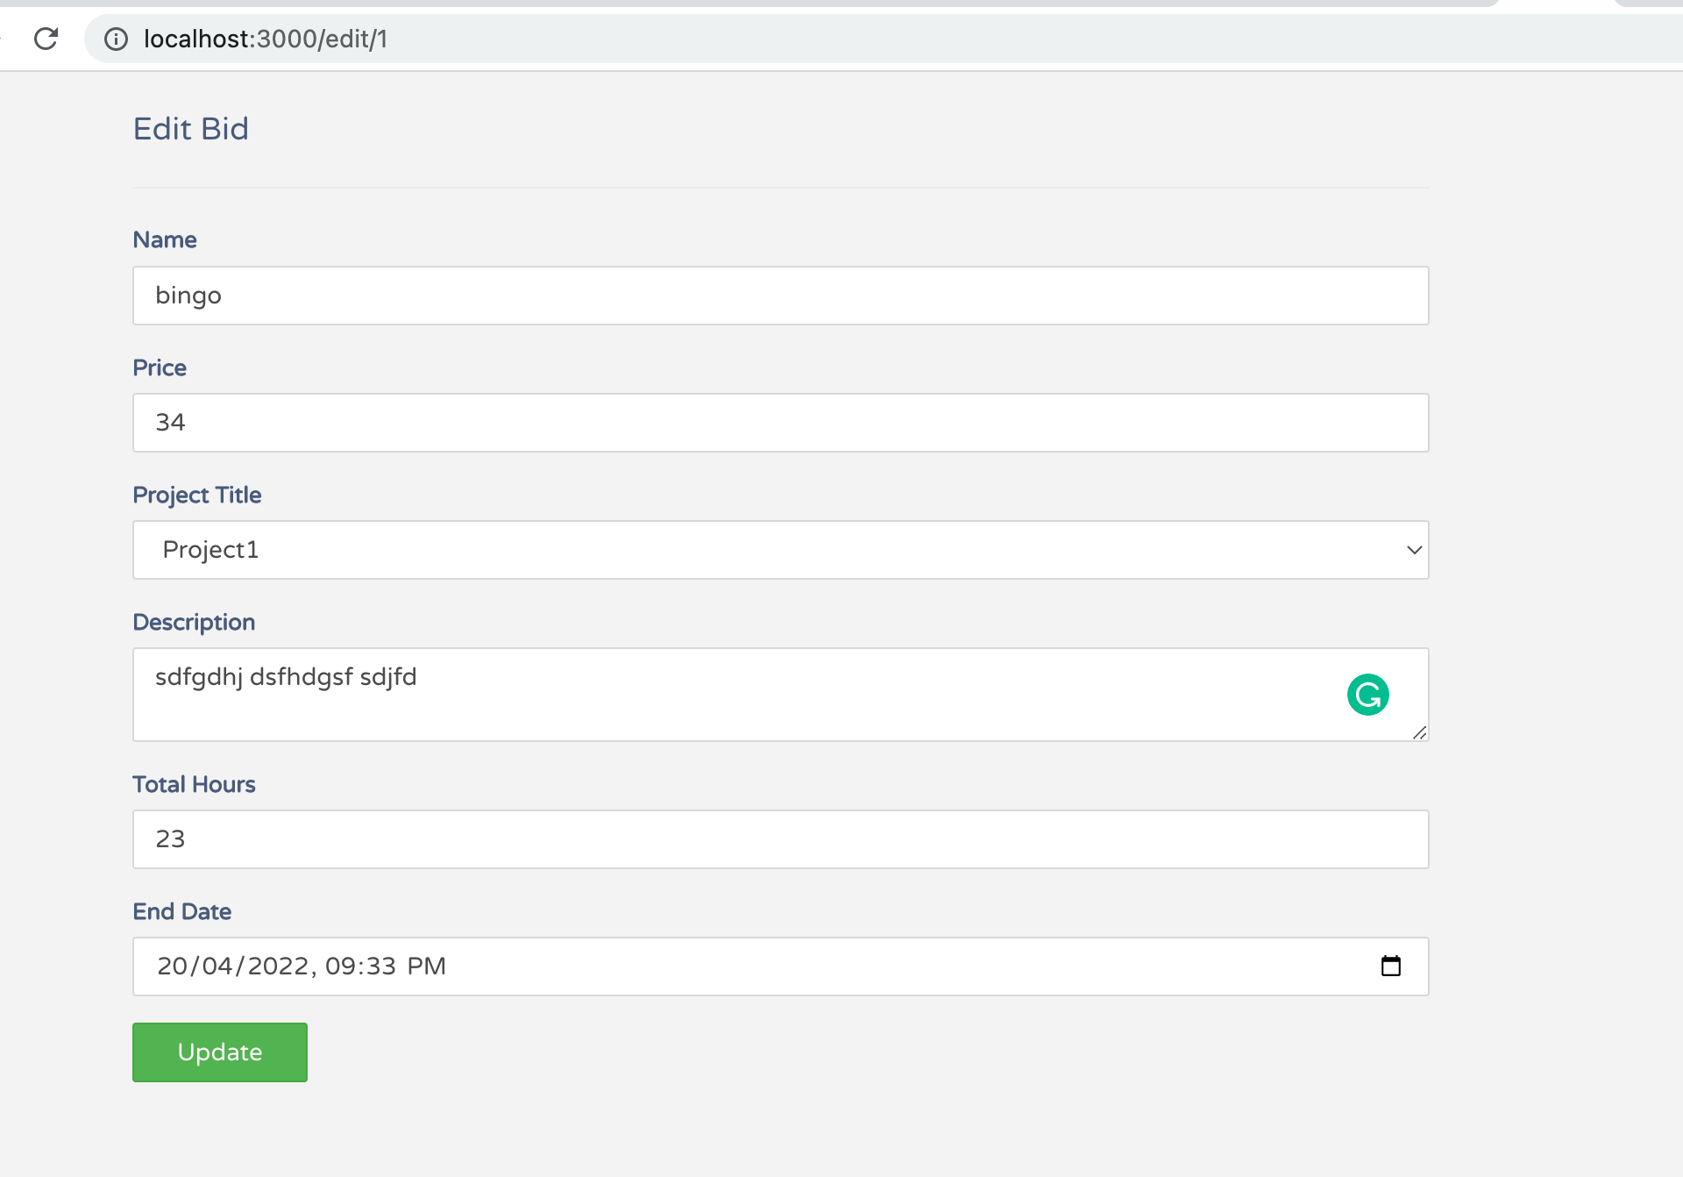
Edit Bid

Slide 12
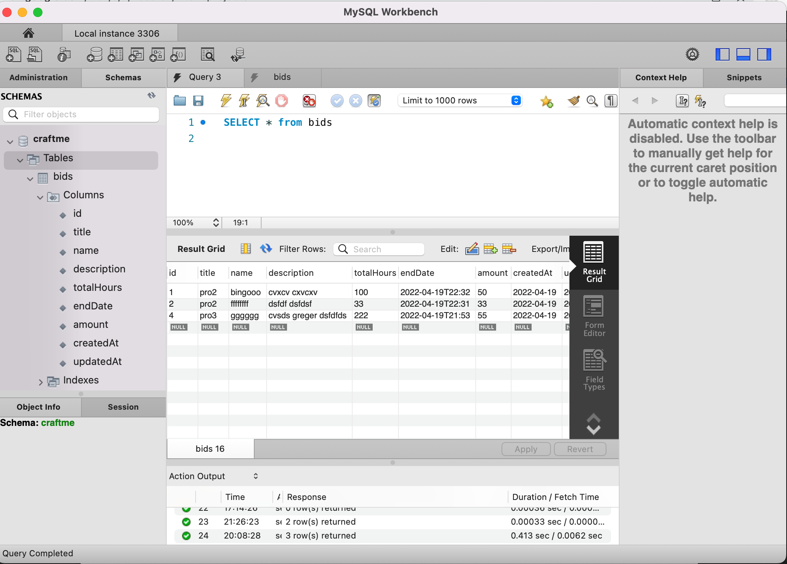
Mysql

Slide 13
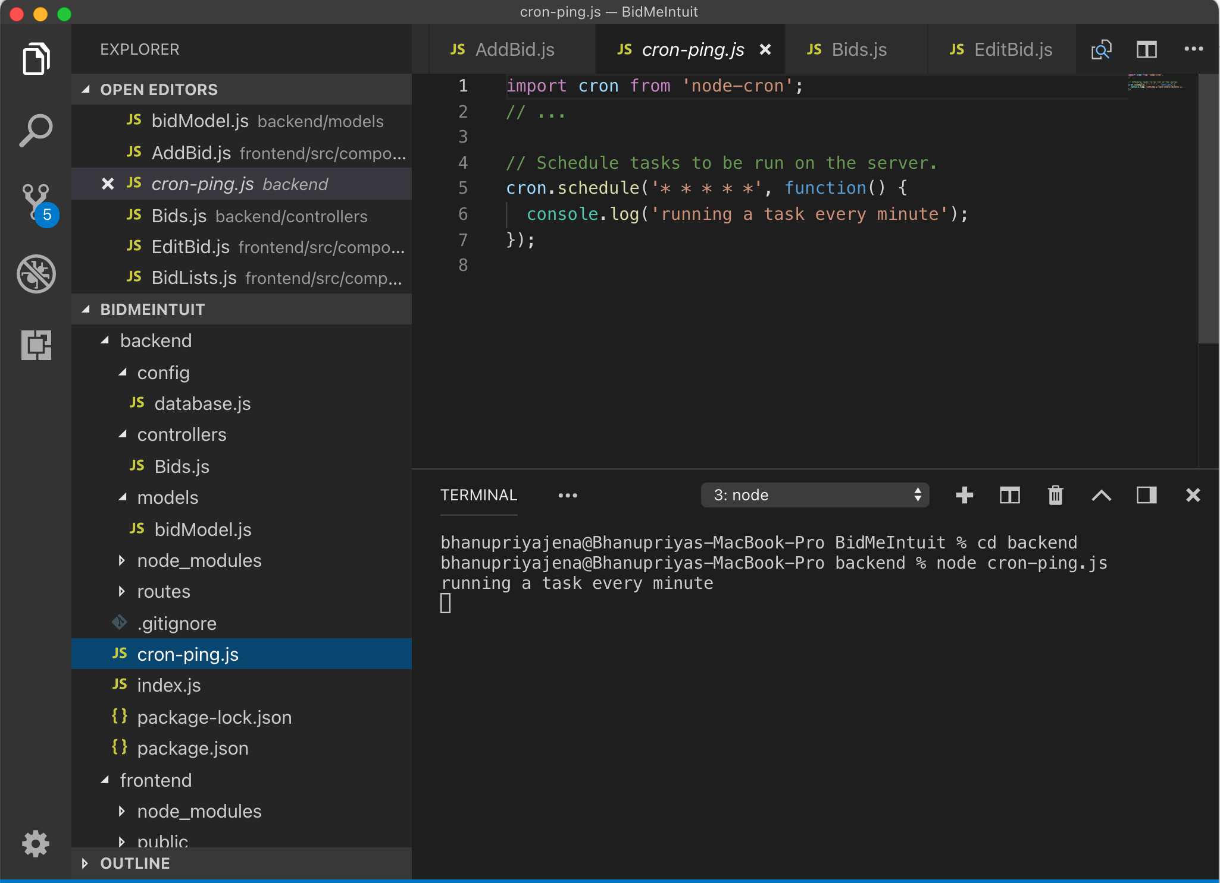
Cron job for scheduling

Slide 14
Why? Intuit
z

Slide 15
Sustainability
Progressive
Resilient
Stable Platform

Slide 16

Q&A
z

